Slide 1

Chapter Academy June Session
June 10, 2021

Slide 2

How do I know whether in-person, virtual, or hybrid is right for my chapter?
How do I know whether in-person, virtual, or hybrid is right for my chapter?

Slide 3
Poll:
Temperature Check – Where is your chapter with it’s 2021 event strategy?
Our chapter has everything already all planned out for 2021.
Our chapter has a partial plan, but we need a few more tips.
Our chapter has started planning, but nothing concrete is in place.
Our chapter has no idea what to do.

Slide 4
What is Hybrid?
Hybrid Events = Concurrent live and virtual components
Blended Events = Combine live and virtual components, but not necessarily always concurrent

Slide 5
Questions to ask: In-person, virtual, hybrid?
Is my chapter’s state/region open for in-person events?
What are the guidelines for gathering in person?
What are the costs associated with gathering in-person, virtually, or in a hybrid/blended capacity?
What is the budget for the event?

Slide 6
Questions to ask: In-person, virtual, hybrid?
How much time do we have to plan the event?
How big of a planning team does the chapter have?
What does our chapter planning team already know how to do?
Have we asked our members what type of event they would prefer to attend?

Slide 7
Planning Considerations
Poll your audience!
  Ask questions, provide options, don’t make decisions in a volunteer vacuum!
Registration fees vary by event type, but given the trade-offs between meals and technology expenses, fees can be similar for in-person and virtual events
  You can always include price sensitivity in your polls!

Slide 8


Slide 9

Decision made!
Now how do we pull it off?

Slide 10

In-Person Considerations

Slide 11
In-Person Legal Considerations
Know the standard of care for hosting in-person events
  Follow local, state and federal guidance
    Reopening tracker (state)
    CDC guidelines
Consider attendee waivers for in-person attendance
  Add a provision whereby attendees agree to engage in certain health and safety conduct
Force Majeure clauses for venue contracts
Postpone in lieu of cancellation of in-person events
  Negotiation is important
    moving to a future year and apply all deposits paid; no cancellation fees
    consider the possibility of reduced attendance – fewer guest rooms and reduced f&b spend
For new venue contracts, add a re-booking clause to the cancellation clause

Slide 12
In-Person Health & Safety Considerations
Stay up to date on local, state and federal guidelines, laws, and requirements
Clearly communicate safety measures and cleaning protocols
Set meeting rooms that allow for distancing (current recommendation is 6’) & manage room capacity
Offer touchless check-in
  Low or no cost registration platforms that provide QR/bar codes (Eventbright)
Have clear exit procedures in place to avoid overcrowding at the end
Consider requirements for proof of vaccination or negative COVID test
Contract outside provider for onsite health screening and testing

Slide 14


Hybrid and Virtual Considerations

Slide 15
Hybrid Experiential Considerations
You are designing two separate experiences, two separate value propositions
Don’t force true hybrid, it’s okay for the experiences to be similar, but different!
  Examples:
    Live stream your content sessions, but offer separate networking opportunities for your face-to-face and virtual audiences
    Live stream your primary / general session room, but offer additional breakout sessions on-demand after the event is over
Designate an individual to be the point-person responsible for each experience, designing these opportunities together, but executing them individually makes the experience more manageable.

Slide 16
Best Practices: Hybrid/Virtual Pre-Planning
Every platform is different and has pros and cons
Know your team’s:
  Must Haves
  Nice to Haves
  Don’t Needs
Start sooner than later
  Event plans – 1 year out
  New platform – 9 - 12 months out
  Event design – 6 months out
  Content – 3 - 4 months out
  Registration – 2 - 3 months out
  Event Comms – 3 months out – Day of
Questions to consider:
  Is the event live or pre-recorded?
  Do your attendees want to consume content or connect with one another? Or both?
  Do you need technical (platform and AV) support or can you DIY?
  Do you need to include suppliers or an industry solution center?
  Are 1:1 or group networking meetings required?
  What is your budget?
Notes:
Every platform is different. Each has their benefits and challenges. Knowing your virtual event must haves, nice to haves, and don’t needs is essential to aligning your event needs to the platform that works best for you. Knowing these elements at the outset greatly reduces the number of platforms and options you need to fully explore.

Slide 17
Technology Considerations
Internet connectivity is essential – the worst thing that can happen is bad audio / poor connectivity
AV equipment & labor is expensive, ensure that you are budgeting or scaling your operations appropriately
Start small
  Podcast > Webinar > Virtual Meeting > Virtual Conference > Multiple Tracks, Multiple Days > Blended Conference > Blended Event with Multiple Tracks > Complete Hybrid Event

Slide 18
Keeping AV Costs Down
Not everything has to be live
When you do go live, go simple – limit the number of rooms that are live at the same time, number of cameras, AV staff
Hotel “Complete Meeting Packages” often include basic AV & internet
Use the skills of volunteers or equipment owned by the chapter
Use free (or low cost) tools

Slide 19
HOWEVER…
Keeping technology and AV costs down to the detriment of attendee experience is a huge red flag.
If attendees cannot hear, see, or understand how they are supposed to engage in a virtual setting, they are not going to participate

Slide 20







Free* Resources / Platforms

Slide 21

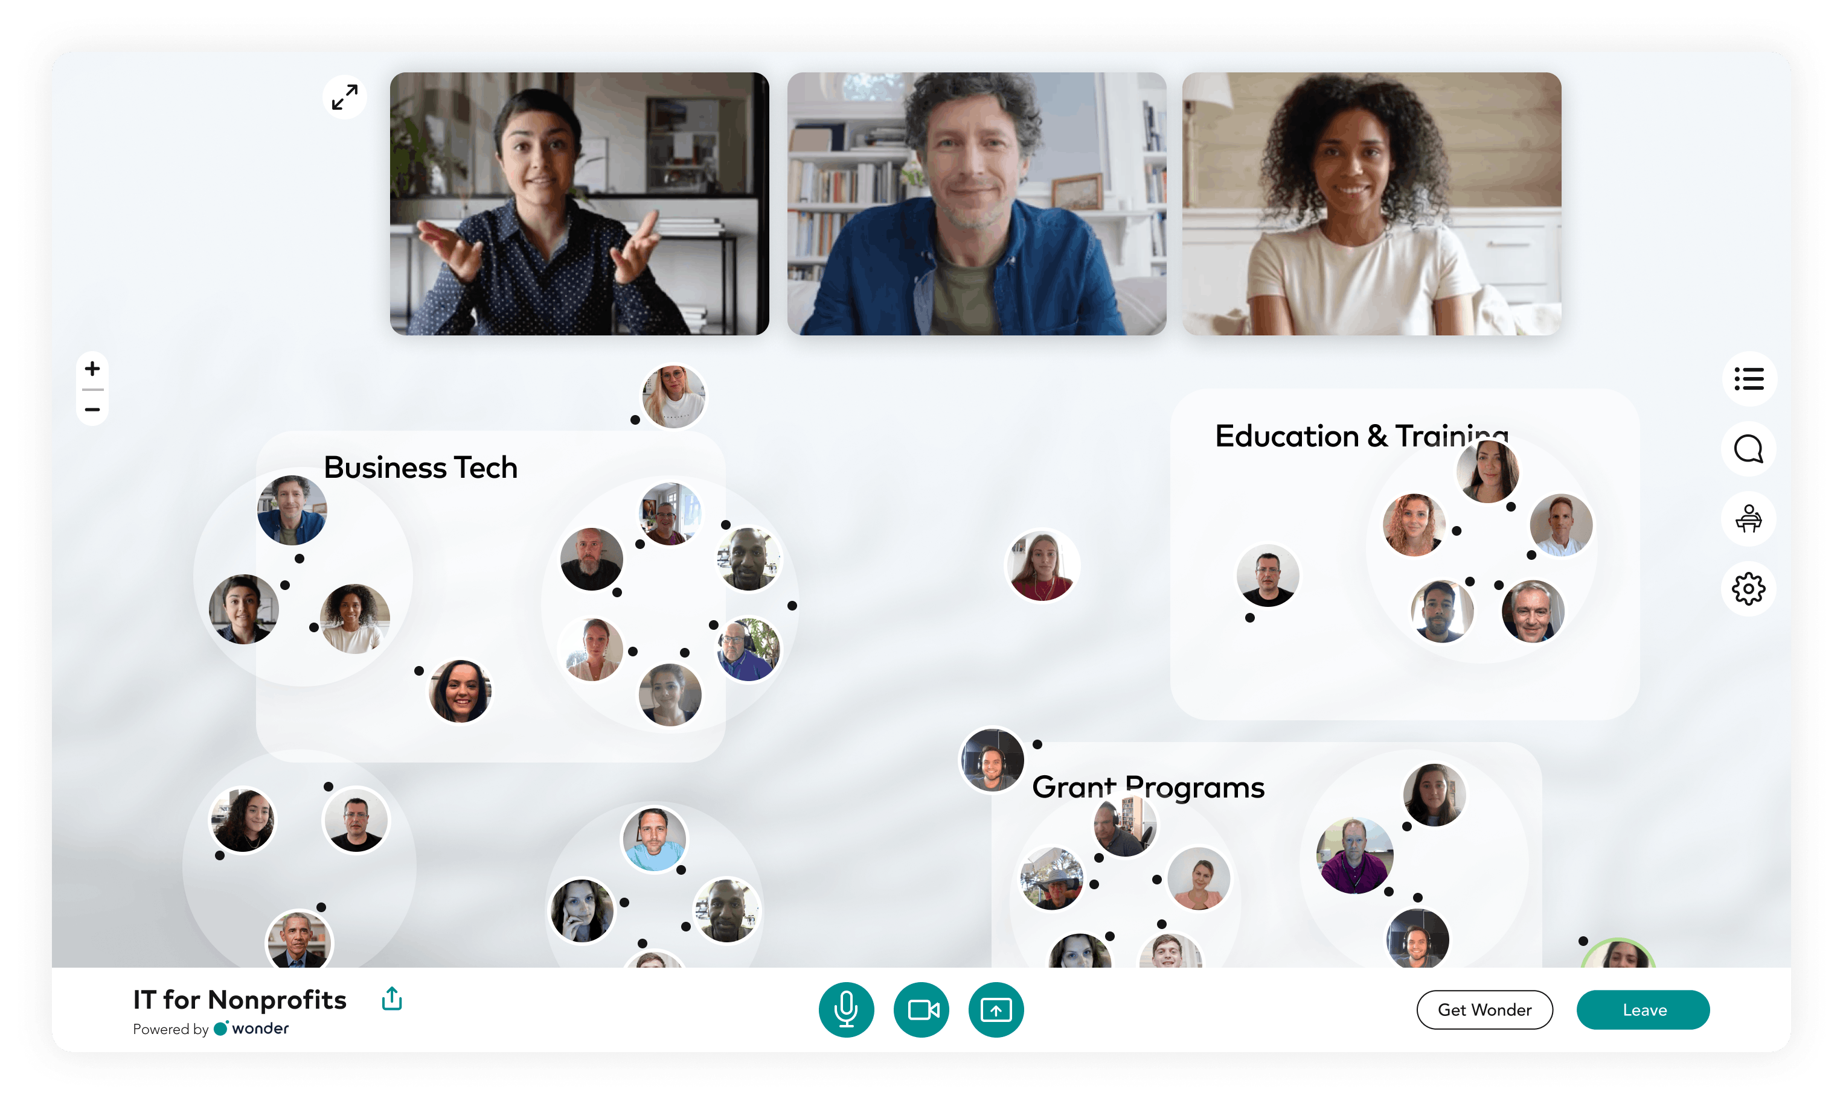
Jenn’s Gem!

Slide 22
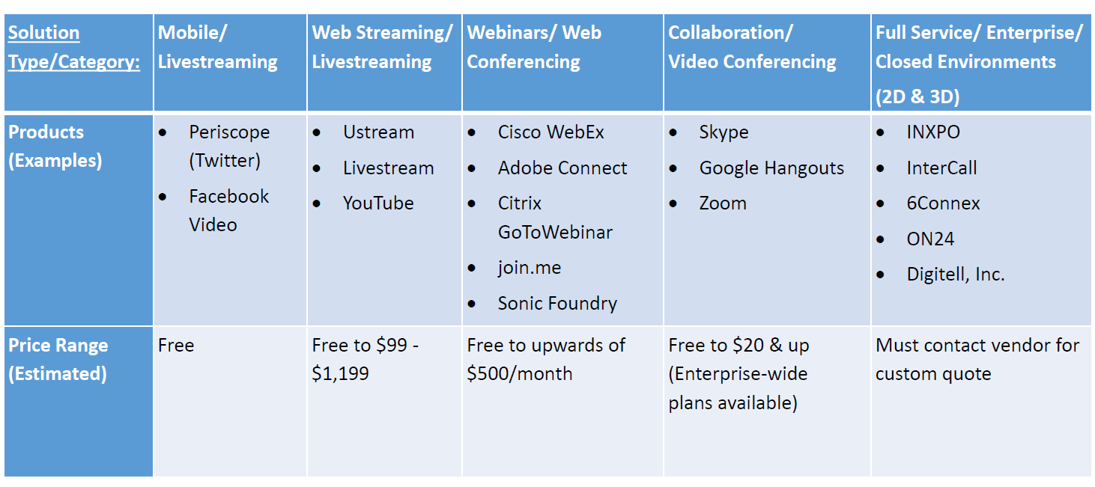
Other Virtual Solutions

Slide 23
Even More Virtual Solutions
Amazon Chime
Vimeo
Hopin
Vfairs
Airmeet
ON24
Intrado
VConferenceOnline
CNTVnow
Digitell
Streamyard
Glisser
Klik
EventMAX (G2Planet)
Kahoot

Slide 24
Best Practices: During the Event
Keep the planning team connected
Assign clear roles for handling technical facilitation, technical issues, and registration
Have a plan B for when technical issues arise
Questions to consider:
  Will you allow late registration? Who is in charge of getting late registrants into the platform?
  How will the planning team communicate when issues arise?
  Do you have back-up hosts/facilitators in each virtual room, in the event of bad weather/internet connections?
  How will you handle a situation where a presenter is unable to present due to a similar situation?

Slide 25
Best Practices: Post Event
All events need feedback to improve in the future
Asking the right questions of your attendees will help your planning team make better decisions
Ask your attendees and your suppliers different questions
Questions to consider:
  Do your attendees & suppliers enjoy (and receive value from) the virtual event format?
  Is a virtual or hybrid event a short- or long-term solution?
  Can you incorporate more live elements in the future?
  Which speakers or facilitators would you invite back?
  What types of experience improvements would your attendees & supplier partners like to see included?

Slide 27
Poll:
Do virtual events cannibalize your in-person attendance?
FACT
FICTION

Slide 28
Cannibalization of Your Face-to-Face Audience = FICTION
This conversation has loomed in the events industry since long before COVID-19
Research on this topic from PCMA shows that in fact virtual attendance builds in-person attendance over time
In the short-term, while entity permissions and funding for travel and events remains limited, virtual allows you to continue to hold the attention of your chapter audiences
By emphasizing the power of your in-person events, virtual attendees will feel the FOMO (Fear Of Missing Out) and be ready to return in-person as soon as their entity allows

Slide 29

How can we keep all audiences engaged?

Slide 30
Poll:
What types of engagement tactics are you already using at your events?
Panel discussions with diverse speakers and voices
Incorporate polling and live Q&A
Games and social challenges
Live networking

Slide 31
Defining Engagement
Psychological engagement = participants are processing the content
Behavioral engagement = overt activity in the service of learning – physically moving in some way during the presentation
Three levels = Conversation > Collaboration > Collective Action
Social Learning = participating with others to make sense of new ideas
More Social Learning = More Engagement

Slide 32
5 Remote Attendee Needs for Engagement
Recognition and acknowledgement
Connections to both in-person and remote attendees
Dedicated stream and moderator (and Twitter #hashtag)
Dedicated hybrid concierge / help desk
Schedule of live streamed and virtual only sessions

Slide 33
Going Beyond Content
Networking
  Wonder Networking Rooms
  Breakout Rooms and Ice Breaker Questions
Social Activities
  Musical performances
  Bartending or cooking demos
  Magic shows
  Yoga classes
  Trivia
  Bingo

Slide 34
Engagement Ideas
Ice Breakers
Virtual Host
Talk show-style interviews
Having a host to connect the virtual audience to the live experience
“Person on the street” interviews with attendees, speakers, exhibitors…
Text Chat, Q&A, polling, etc. during sessions
Live video networking opportunities

Slide 35
Engagement Ideas
Gamification
Have your speakers speak directly to the camera/virtual audience
Provide conversation topics for discussion in the room and in chat
Have virtual moderators share feedback and discussion from the virtual audience with in-person attendees

Slide 36
Engagement Tools
Slido – live polls, Q&A, word clouds, quizzes
Virtual Braindates – small group conversations on shared areas of interest
Mural – Online collaboration
Interact Quizzes
Vocal Video – Video testimonials (marketing)
Restream – live stream to multiple social platforms
SurveyMonkey

Slide 38

How do we engage speakers productively?

Slide 39
Working with Speakers: Hybrid & Virtual
Make sure your speakers know the format in which they will be presenting – live, hybrid, or virtual only
Make sure speakers know that they will be recorded – negotiate before selections are “final”
Collect speaker release forms – ensure you can have content recorded and available on-demand
Ask speakers to provide a brief 90-second clip to advertise their session for use in your marketing promotions / social media
Provide training on expectations and best practices
  NIGP Speaker Tips Sheet
Coaching speakers on engaging the virtual audience is a key factor in ensuring that your virtual audience is engaged
  Speak directly to the virtual audience, provide in-room and virtual engagements

Slide 40
Hybrid & Virtual Speaker Tips
At the beginning, welcome both the face-to-face and remote audiences. Welcome those online into the room.
Take at least four discussion breaks in a typical 75- to 90-min presentation.
Ask the digital audience to introduce themselves in a unique fashion, such as describing their current mood as a type of weather. There are plenty of icebreakers one can use. Then ask your face-to-face audience to turn to their neighbor and discuss something presented.
Whenever you give the face-to-face audience a discussion question, turn and talk directly to your remote audience.
  Ask your AV team to turn down the house sound but keep it live for the remote audience.
  Look directly into the camera and ask the remote audience to text/tweet their response to your question.
  Keep talking for a few minutes to the remote audience and then go to your recruits/assistants and ask them about the online conversation so far. Make sure to introduce your moderators to the remote audience. Bring a wireless microphone that has no house sound with you for the moderator. That way the remote audience can hear and see the discussion.
  Include commentary from the remote audience when debriefing discussion questions.
  At the end, invite the face-to-face audience to log online and see the discussion from the remote audience.
Thank both the face-to-face and remote audience for playing along with you and each other.

